Slide 1
Two Dimensional Principal Components of Natural Images

Slide 2
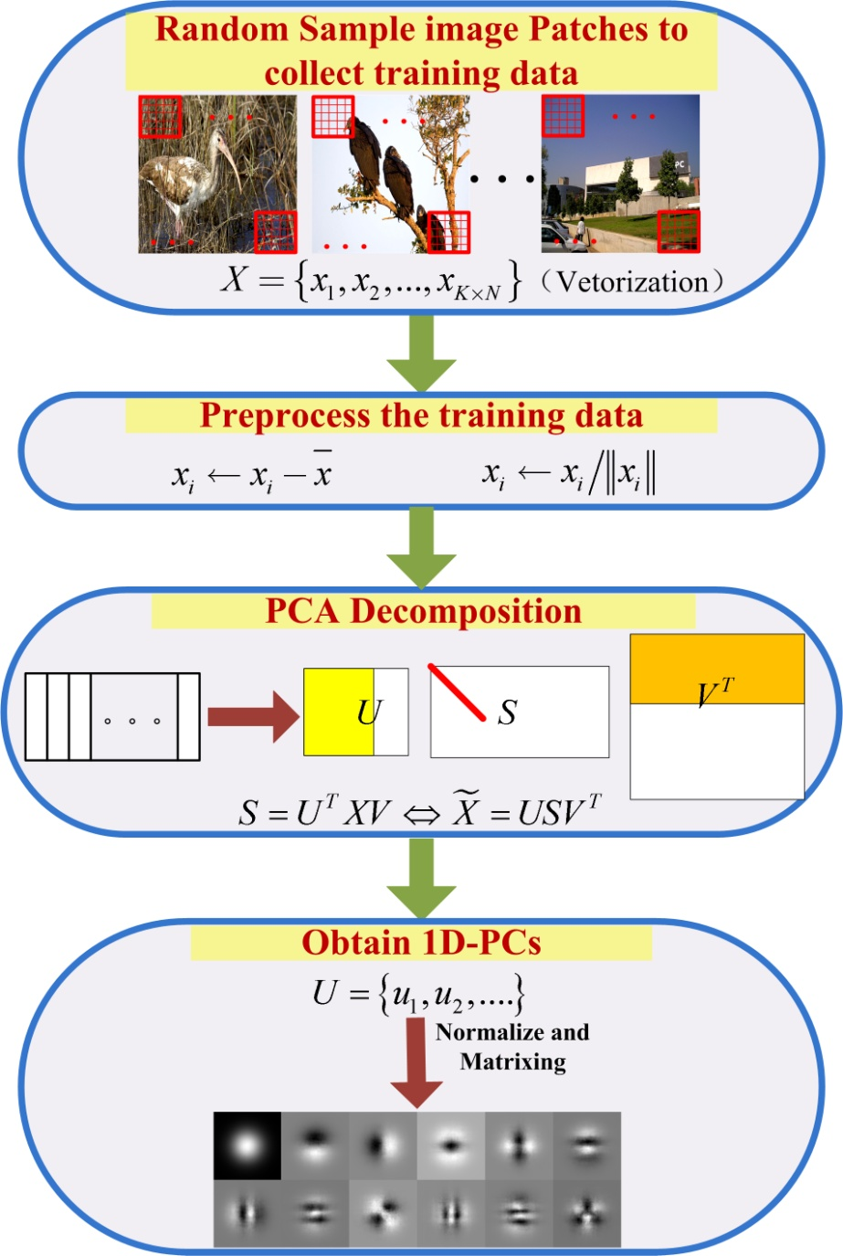
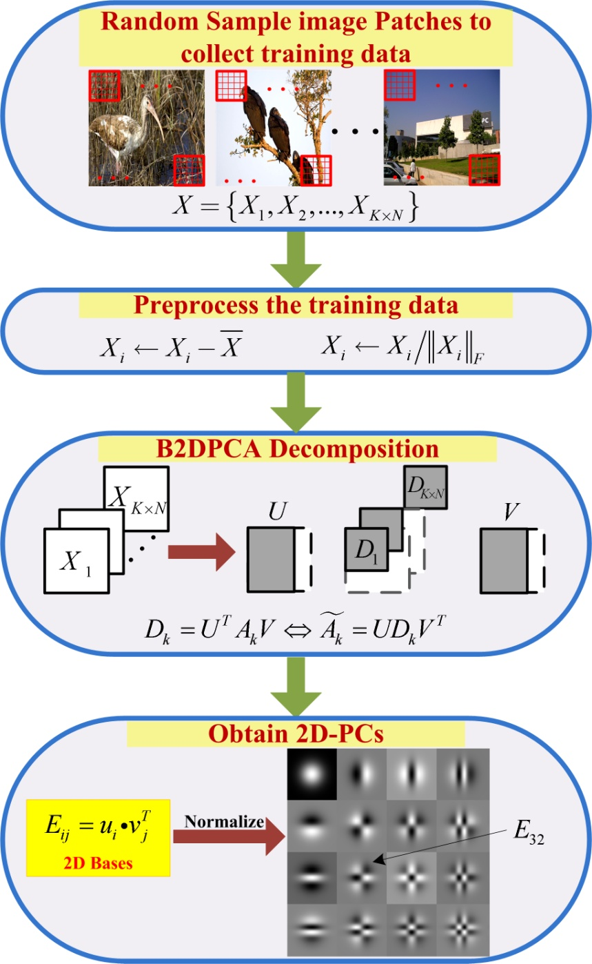
1DPCs
2DPCs

Slide 3
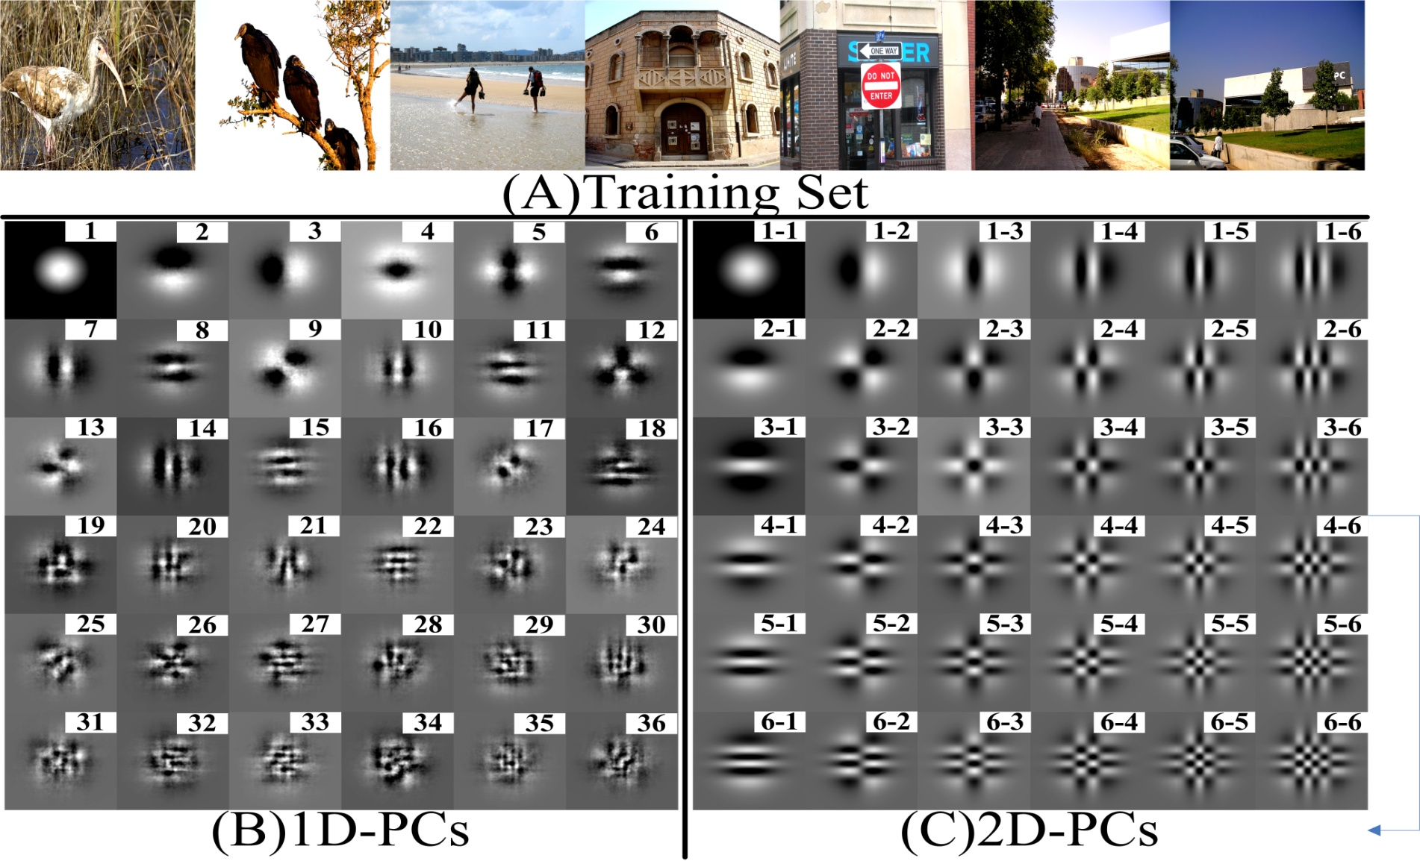
surprising symmetry stable regularity
good interpretability low complexity

Slide 4
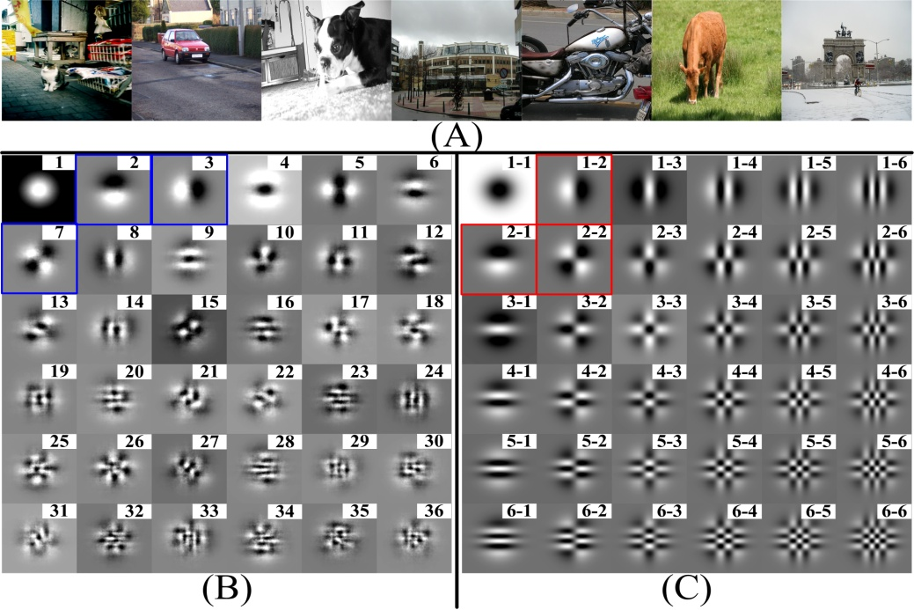
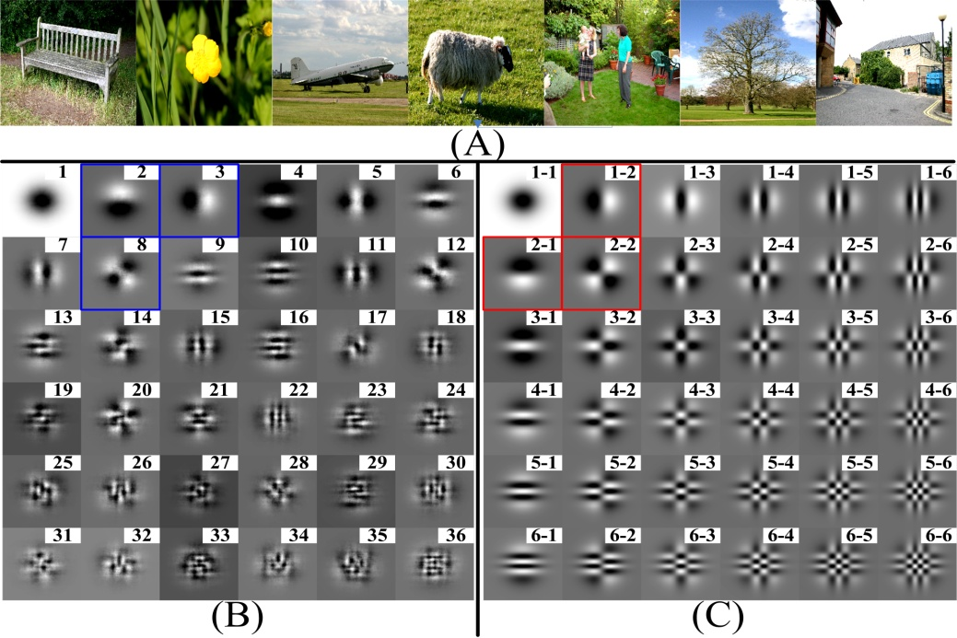
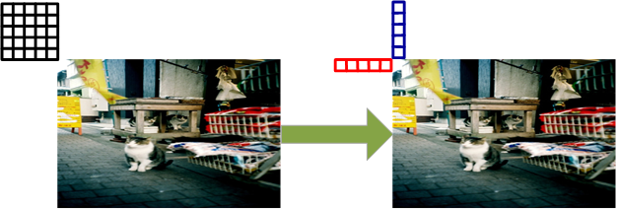
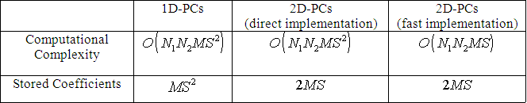

Slide 5
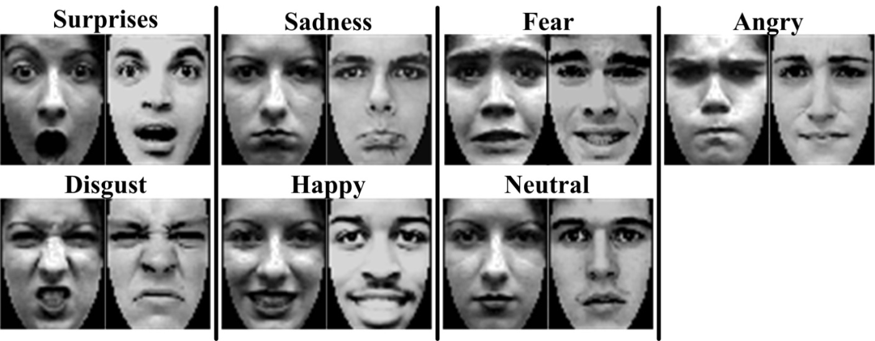
Multi-class Expression Recognition
Data Base：
See paper for detail results

Slide 6
Main References:
1.Texture representation based on pattern map
Author(s): Zeng XY, Chen YW, Nakao Z, Lu HQ
Source: SIGNAL PROCESSING Volume: 84 Issue: 3 Pages: 589-599 Published: MAR 2004
2.Generalized 2D principal component analysis for face image representation and recognition
Author(s): Kong H, Wang L, Teoh EK, Li XC, Wang JG, Venkateswarlu R
Source: NEURAL NETWORKS Volume: 18 Issue: 5-6 Pages: 585-594 Published: JUN-JUL 2005
3.The principal components of natural images revisited
Author(s): Heidemann G
Source: IEEE TRANSACTIONS ON PATTERN ANALYSIS AND MACHINE INTELLIGENCE Volume: 28 Issue: 5 Pages: 822-826 Published: MAY 2006
4. The principal components of natural images
Author(s): HANCOCK PJB, BADDELEY RJ, SMITH LS
Source: NETWORK-COMPUTATION IN NEURAL SYSTEMS Volume: 3 Issue: 1 Pages: 61-70 Published: FEB 1992

